Slide 1
Data collection from the simulation: Sensitive Detectors
Lecture 7

Slide 2
In this lecture
We will discuss SensitiveDetector and PrimitiveScorer and how they can be used to collect data from the simulation
Example: same silicon strip detector and isotropic alpha source as in lecture 6!
We again will use several methods to collect the “same” thing: distribution of alpha particles count on detector strips – both previous methods with UserActions and now with SensitiveDetectors
We will write our own sensitive detector and process hits in it
We will use two custom hit collections and primitive scorers to count alphas and collect energy
UserActions – equivalent to previous lecture

Slide 3
What is sensitive detector
It’s another way to collect data from the simulation
In lecture 6 we got every step in SteppingAction and checked conditions ourselves – volume name, particle name, etc.
G4VSensitiveDetector – you inherit it and write a class which represents your detector
You attach it to a logical volume. Then Geant4 calls your ProcessHits() for each step which starts in this volume
All placements and replicas share one SD instance within each worker. You get strip number only from a copy number which you get from step in ProcessHits() .
In ProcessHits() you decide what to keep from the step and store it as a hit – object of your own class inherited from G4VHit
Hit can store whatever you want: energy deposit, position, time, strip number, track length, etc… You can accumulate values or save data from each step! Don’t store pointers to step or track though
All hits from one event are accumulated in hits collections – typically you analyze it at the end of the event

Slide 4
Creating sensitive detector
Sensitive detectors are created in DetectorConstruction::ConstructSDandField()
It is called in each thread – each worker has its own sensitive-detector instance, like user actions
First you create it and then you set it to a logical volume
auto stripSD = new StripSD("StripSD", "StripHitsCollection", "StripSumsCollection");
G4SDManager::GetSDMpointer()->AddNewDetector(stripSD);
SetSensitiveDetector("StripLV", stripSD);
StripSD constructor sets the detector name and the names of its two hits collections
AddNewDetector() – registers the detector and its hit collections in G4SDManager
SetSensitiveDetector() – attaches the detector to the logical volume with this name. All 100 strips use the same sensitive detector!
You can put several sensitive detectors to one volume! But you should use DetectorConstruction's SetSensitiveDetector("StripLV", stripSD) in ConstructSDandField(), not method G4LogicalVolume::SetSensitiveDetector – this one will just replace the first sensitive detector!

Slide 5
Sensitive detector in the simulation loop
Initialize() – called by Geant4 at the start of each event, before BeginOfEventAction(). Here we create two new hits collections and add them to the event
ProcessHits() – called by Geant4 for each step which starts in the sensitive volume
EndOfEvent() – called by Geant4 when all tracks of the event are finished, before EndOfEventAction()
ProcessHits() is called before UserSteppingAction() of the same step – if you kill a track in SteppingAction, the detector has already seen this step
Step belongs to the volume where it started: the step from World into a strip is not seen by the detector!
Each hits collection belongs to one event in one thread – each is deleted with the event and never merged between threads
So in EndOfEventAction we get the hits and move results to histograms or accumulables created in RunAction – similar to before

Slide 6
G4MultiFunctionalDetector
You can also use a ready-made Geant4 sensitive detector: G4MultiFunctionalDetector
You register primitive scorers in it – G4VPrimitiveScorer. Each scorer accumulates up one quantity in event: deposited energy, dose, number of steps, track length, current, flux…
auto mfd = new G4MultiFunctionalDetector("StripMFD");
mfd->RegisterPrimitive(new G4PSEnergyDeposit("Edep"));
There are many primitive scorers, part of them documented here: https://geant4-userdoc.web.cern.ch/UsersGuides/ForApplicationDeveloper/html/Detector/hit.html#concrete-classes-of-g4vprimitivescorer
Full list of scorers you can check in Geant4 source folder: source/digits_hits/scorer/include/
By default primitive scorers will save and use a copy number of a volume for accumulation – so you still are able to get info from separate strips!

Slide 7
Typical workflow for sensitive detectors
Create histograms in RunAction as before
Create sensitive detectors and connect them to logical volumes from which you want some data
Sensitive detector work as replacement of SteppingAction. Previously you checked name of volume and send the data to containers in EventAction, with SD – each SD or scorer has its own per-event collection, all held by G4HCofThisEvent!
After event has finished, you get hits collection, parse them and fill histograms with data!

Slide 8
Example project
We will use the same example as in previous lecture, but add sensitive detectors to strip
We will create our own sensitive detector and hit: StripSD and StripHit
Also we will use Geant4 primitive scorers and again collect the alpha distribution in five related ways:
1. Our SD: one hit is saved for each depositing step. Strip number and deposited energy are saved. Centroid of energy deposition is calculated and filled in the histogram.
2. Our SD sums: one accumulated hit per strip. Energy is accumulated from each step in the container separately for each strip. Centroid of energy deposition is calculated and filled in the histogram.
3. G4PSEnergyDeposit scorer – similar idea to 2, but using Geant4 scorer. For each deposited strip total energy is accumulated and centroid is calculated.
4. G4PSTermination scorer - we get the strip where the alpha stops in each event
5. G4PSTrackCounter scorer - we count number of alphas entered the strip
The three energy deposition methods should produce exactly the same distribution as the centroid from EventAction+SteppingAction in the previous lecture!
The termination scorer should agree with stop position from TrackingAction
The track counter gives more strip entries: it counts an alpha again when it crosses into a neighbouring strip

Slide 9
StripHit
Hit is an object where you copy or accumulate data from one step which you want to keep. We inherit G4VHit:
Members are private, we set and get them with simple methods of Set... and Get…
Also we have AddEdep - we will use it for sums
Add anything you need: time, particle name, kinetic energy, track length…
Constructor sets default values, fStrip = -1 means “not set”
Copy values, don’t store pointers to G4Step or G4Track! Geant4 uses the same G4Step object for the next step, and G4Track is deleted when its tracking is finished
Structure is taken from Geant4 basic example B2 (TrackerHit)

Slide 10
Hits collection and G4Allocator
Hits of one event are stored in a hits collection. We give it a short name in StripHit.hh:
using StripHitsCollection = G4THitsCollection<StripHit>;
G4THitsCollection – Geant4 template container, vector of pointers to our hits
Geant4 deletes the collection together with the event, and the collection deletes all its hits – we never delete them ourselves
Number of hits depend on what you do: we will have Hit collection and Sums collection!
Creating and deleting many small objects is slow, so B2 uses Geant4 class for it – G4Allocator:
extern G4ThreadLocal G4Allocator<StripHit>* StripHitAllocator;
inline void* StripHit::operator new(size_t)
{
if (!StripHitAllocator) StripHitAllocator = new G4Allocator<StripHit>;
return (void*)StripHitAllocator->MallocSingle();
}
We redefine new and delete for StripHit: it is handled by G4Allocator!
G4ThreadLocal – each thread has its own allocator. It is created in StripHit.cc and filled at the first hit of this thread:
G4ThreadLocal G4Allocator<StripHit>* StripHitAllocator = nullptr;

Slide 11
StripSD – constructor and Initialize()
Constructor gets the detector name and the names of both hit collections
collectionName – member of G4VSensitiveDetector, lists names of all hits collections in this detector. One detector can have several collections! We insert both hit collection names in the constructor
Initialize() is called at the start of each event – we create two new empty collections and add them to Event to G4HCofThisEvent – “hits collections of this event”!
AddHitsCollection() puts our collection into its slot into G4HCofThisEvent and it gets filled during the simulation by ProcessHits!
G4SDManager gives each collection ID by name. We get this ID by using the name
Later we will use it in EndOfEventAction

Slide 12
StripSD::ProcessHits()
ProcessHits called for each step which starts in StripLV – all particles: primary alphas and secondary electrons
We keep only steps with energy deposit. The first collection gets one hit per step; the second gets one accumulated hit per strip
Strip number – copy number from pre-step touchable, like in SteppingAction of lecture 6. Step belongs to the strip where it started
The detailed hit collection fHitsCollection stores energy deposit and strip number from each step – so number of elements is equal to number of steps in the detector!
The sum hit collection fSumsCollection adds energy to strip container – so number of hits is equal to number of strips worked in the event
Return value: true if we made a hit, false if we skipped the step. It is just a report – Geant4 does nothing with it
EndOfEvent() function is empty – both collections are ready there, but we process them in EndOfEventAction to fill histograms

Slide 13
Registering detectors: ConstructSDandField()
We connect two detectors on one logical volume – our detector StripSD and Geant4 premade G4MultiFunctionalDetector
Each scorer is added to G4MultiFunctionalDetector – it will be a separate hits collection
Full collection name is “detector/collection”:
"StripSD/StripHitsCollection", "StripSD/StripSumsCollection" – our hits collections
"StripMFD/Edep", "StripMFD/Stop", "StripMFD/Count" – hits collections of G4MultiFunctionalDetector
Each scorer is called for each step which starts in the strip (and passes its filter), and adds a number to this strip:
G4PSEnergyDeposit – adds energy deposit of the step in separate container for each strip
G4PSTermination – adds 1 if track is stopped in the strip. Doesn't work if track is killed in SteppingAction!
G4PSTrackCounter with fCurrent_In – adds 1 if the step starts on the volume boundary – it counts all alphas which entered the strip
Scorer gets strip number from copy number. It finds it itself, we don’t write anything for it!
G4SDParticleFilter – we can add particle filter to only use alphas in scorers! One filter can be used by several scorers. We will not add it to G4PSEnergyDeposit – electrons deposit energy too.

Slide 14
Scorer results: maps
Output uses C++ std::map<key, value> – container of pairs {key, value}, sorted by key
Scorer stores its result in G4THitsMap<G4double> – Geant4 mostly renamed and added upon std::map<G4int, G4double*>
  key – strip number (copy number of your volume), always unique!
  value – pointer to the accumulated number, so we dereference it: *entry.second
Only strips where something was scored are in the map:
  alpha deposited energy in one strip – one pair, crossed a border – two pairs, missed the detector – empty map
Value is always G4double, even for counters: you can set different weights for particles. For us counts are 1.0, 2.0…
These scorers save their results as G4THitsMap<G4double>
Like our hits collection which we added to an event ourselves, the scorer maps belong to one event in one thread. We use it in EndOfEventAction to fill histograms!

Slide 15
EndOfEventAction: getting collections and writing histograms
In EndOfEventAction we get hits collections and use them to write histograms
First we use the same the name set in DetectorConstruction – from G4SDManager, to get ID of collection. Wrong name – ID is -1, and you get garbage data or crash!
event->GetHCofThisEvent() – all collections of this event, GetHC(ID) – one of them
GetHC() returns G4VHitsCollection* – pointer to the base class:
  G4HCofThisEvent keeps collections of all detectors in one vector – our two StripSD collections and scorer maps together
  G4HCofThisEvent was prepared with Geant4 base class, so we need to recast out collection type on it!
static_cast<Type*>(pointer) – we tell the compiler what the object really is. After that we can use its methods
static_cast does not check anything! Wrong type – garbage or crash. dynamic_cast checks and returns nullptr if the type is wrong
We cast the whole collection once – then (*hcSD)[i] already gives StripHit*

Slide 16
RunAction: two output files
We will use 2 output files to save histograms: 1 for histograms of Lecture 6 – strips_UserActions, other for new histograms - strips_SD
Histograms 5-9 are created in RunAction constructor, after histograms 0-4 of lecture 6
We set it in BeginOfRunAction:
analysisManager->OpenFile(userActionsFile);
for (G4int id = 5; id <= 9; id++) {
analysisManager->SetH1FileName(id, sensitiveDetectorFile);
}
OpenFile() opens the main default file – all histograms go there if SetH1FileName is not called
SetH1FileName(ID, filename) – we use this to send histograms from sensitive detectors in another file. We don’t open this file ourselves, it is created when histograms are written
We set them each time in BeginOfRunAction of every run. If you set them once in constructor, the second run crashes when writing!

Slide 17
Histograms
Histogram 5 - same energy weighted centroid as histogram 0 in lecture 6, but energy comes from hits – not from fEdeps filled in SteppingAction
We loop over all hits – about 1700 in each event with alpha. Strip of each step is stored in the hit!
sumE and sumEX were already used for histogram 0 – we just set them to zero again
Histograms 6 and 7 – centroid, but from accumulated values
Histogram 6 uses sums collection, histogram 7 – energy deposit scorer
Histograms 0, 5, 6, 7 should be exactly the same – we calculate centroid of deposited energy in all of them!
Histogram 8 – we fill the strip where particle has stopped – should be very close to histogram 1, which we fill in PostUserTrackingAction! Only difference will be from particles stopped on the border of 2 strips – scorer used volume where step started, tracking action – where its ended
Histogram 9 – we fill all strips in which alpha particle has entered in the event – so it will overcount in comparison with other hists: some alphas hit 2 strips in one event!

Slide 18
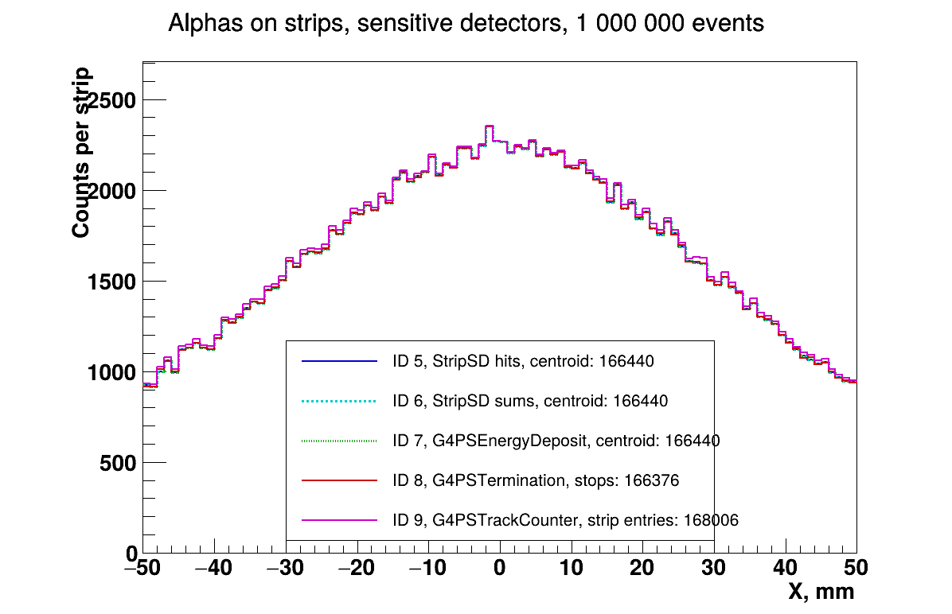
Results: strip distributions
1 000 000 events, 20 threads: 166 440 alphas entered the detector (SteppingAction and accumulables)
Histograms 5 (hits), 6 (sums) and 7 (G4PSEnergyDeposit) are the same as histogram 0 in every bin
Histogram 8 (G4PSTermination): 166 376 stopped alphas - same as histogram 1 from TrackingAction
Histogram 9 (G4PSTrackCounter): 168 006 - 1 566 more (0.9%): it counts entries into strips, not into the detector

Slide 19
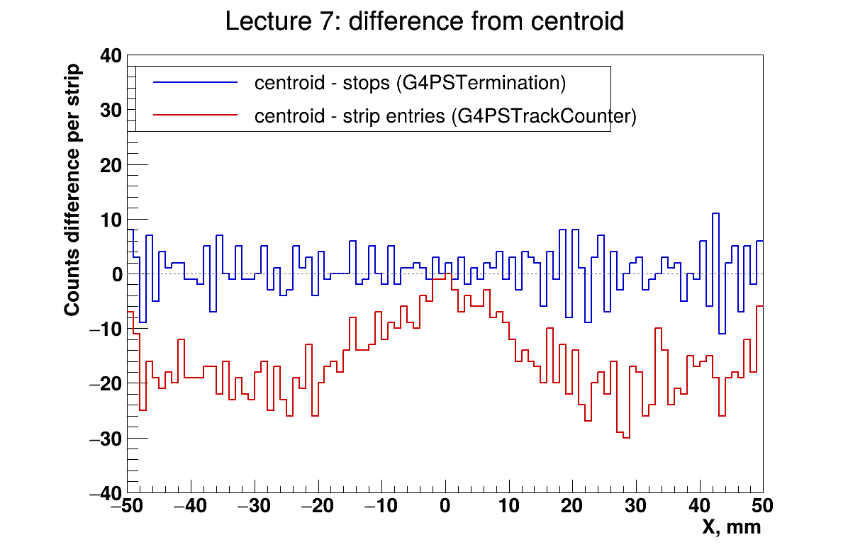
Results: difference from centroid
Picture: centroid (histogram 7) minus stops (histogram 8) and minus strip entries (histogram 9), per strip
Stops: noise around zero, as in lecture 6 - alphas only move to a neighbour strip. In total 64 more in centroid: alphas which left the detector
Strip entries: below zero almost everywhere - the scorer overcounts, an alpha which crossed a border is counted in both strips
Near the center alphas fly almost perpendicular and rarely reach a border. Closer to the edges they come at larger angles and cross more often. Know what you count!

Slide 20
Some homework if you’d like
Collect the range of alpha particle using your own sensitive detector. Add and fill new histogram. Compare with results of previous homework. Be careful and use the same definition of range in both cases!
Add a new scorer G4PSTrackLength. Collect the range of alpha using it and compare with results of previous homework. Again, be careful with definition!
Enable killing of slow alphas. Observe how histograms change.

